Slide 1

The Crime Rate of United States
By Haizhen Huang

Slide 2
Background
According to the Federal Bureau of Investigation and the Bureau of Justice Statistics
The crime rate in the United States has declined since 1990s
Aimed to verify if it exist a declining tendency

Slide 3
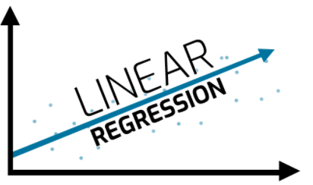
Method
Using the linear model
To aggregate the total frequency of crime by year
Hypothesis：a declining linear relationship between total crime frequency and year.
Test if there exist a tendency between year and total crime frequency.
Visualization: scatter plot with line of linear model

Slide 4
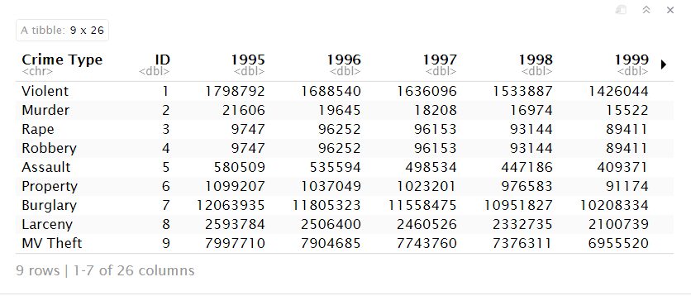
Participants or Observation

Slide 5
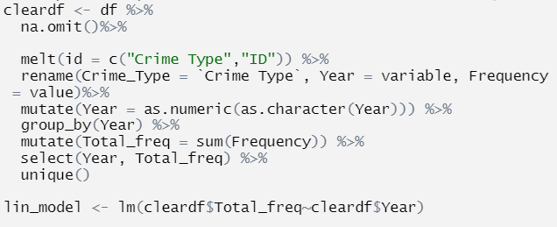
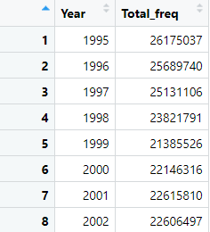
Procedure
Remove NA
Transform to long format
Calculate total crime frequency by year
Remove duplicated rows
Linear model

Slide 6
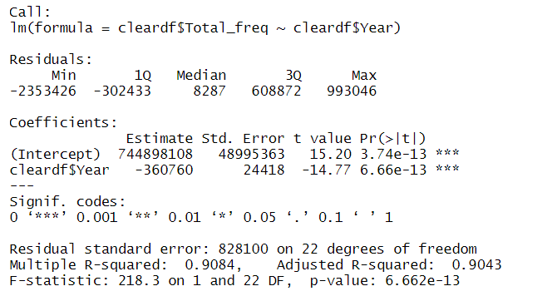
Results
Adjusted R Square: 0.9043
Total crime frequency was explained 90.43% by Year
H0: total crime frequency will not changes if year changes
Ha: total crime frequency will changes if year changes
P-value: 3.74 e^-13
Year is statistically significant to Total crime frequency
Indicated the strongly linear relationship between Year and Total crime frequency

Slide 7
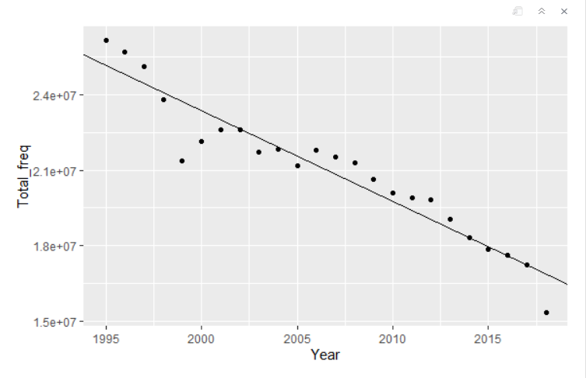
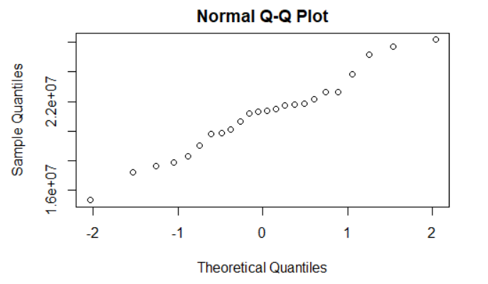
Discussion
Intercept = 744,898,108
Slope = -360,760
744 millions crimes happened in the initial year (0 year)
An average decreasing 360,760 crimes each year from 1995 to 2018s
Linearity and Normality

Slide 8

Limitations
Small dataset only included Year, Crime Type, and Crime frequency
In reality, crime rate should be affected by many factors
Location, income, age or education etc.
Lack of other factors

Slide 9

Conclusion
Year and Total crime frequency are strongly correlated
A declining tendency of crime rate by year
Hypothesis is corrected

Slide 10
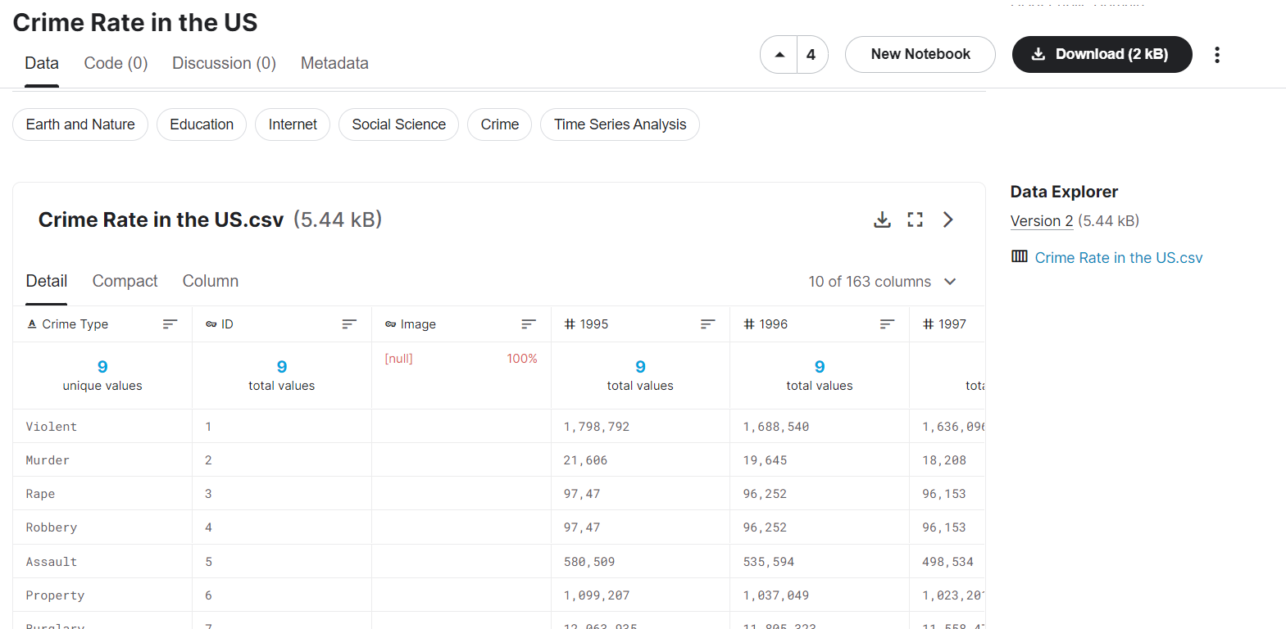
References
Dataset : Crime Rate in the US
From Kaggle
https://www.kaggle.com/datasets/mathurinache/crimerateintheus

